Slide 1

Release 7 Guide for Web Users
Go live date, 31 May 2021

Slide 2
Summary of content
In this document we will cover the following changes to the Portal that are included in Release 7
1. New accident date;
PAP Process only
2. OIC reference number;
3. New Tariffs;
  4. Interim Settlement Pack - Interim Payment Request Breakdown;
  5. Stage 2 Settlement Pack and Interim Settlement Pack - Medical Report;
  6. Stage 2 Settlement Pack - New loss type of 'Tariff' added;
  7. Settlement Pack 2 - S2SP Payment Request Breakdown;
  8. Settlement Pack 2 - Counter Offer;
  9. Settlement Pack 2 - Payment Request Breakdown;
  10. Settlement Pack 2, continued;
  11. New Exit Point;
  12. Removed Exit Reason.
*Please note, the images used throughout this document are subject to change.

Slide 3
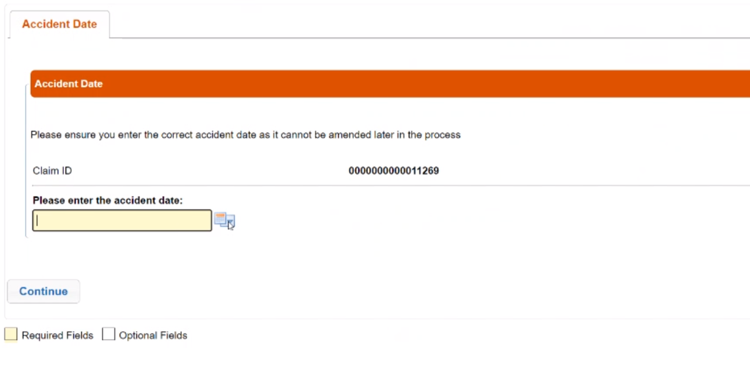
1. New accident date (Applies to both processes)
The Claimant will experience a different journey based on accident date. This page is a gateway to either the existing process or the PAP process.

Slide 4
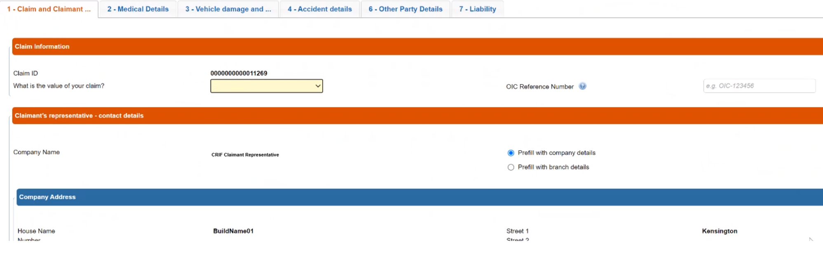

2. OIC Reference Number
In the PAP process only, the Claimant has the option to enter the OIC Reference Number
This new field will appear in the following activities only:
Activity: Activity 0_10 – Claim Data Input/Edit (CR)
Activity: F_0_25_AcceptClaimDecision (COMP)
Process Details page, which is an icon button available in the Worklist and in the Search List, so in case this reference number can be always retrieved both from the COMP and the CR.

Slide 5
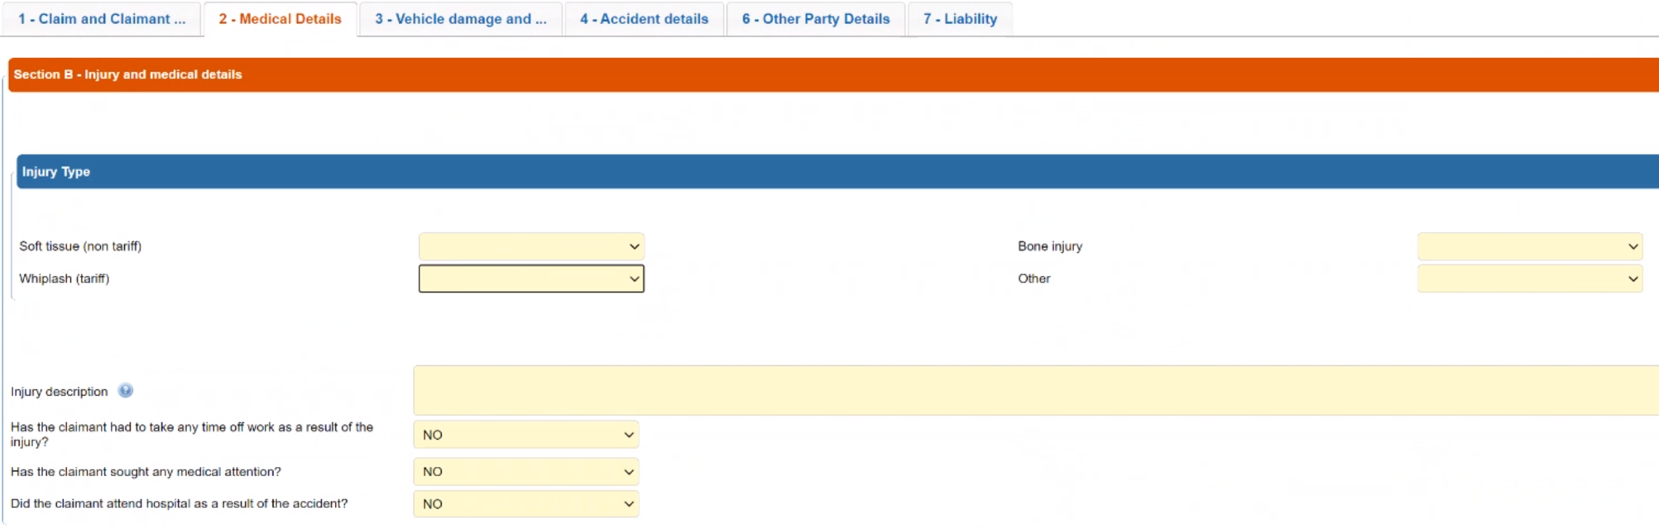
3. New Tariffs
The Injury Type dropdown selection contains four injury options; among these four, two have been amended to specify Tariff/Non-Tariff.
Soft-tissue (non-tariff)
Whiplash (tariff)

Slide 6
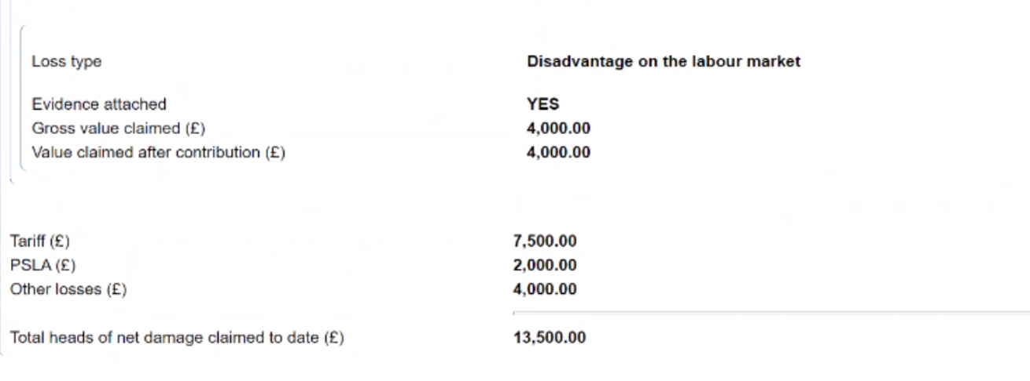
4. Interim Settlement Pack - Interim Payment Request Breakdown
Breakdown of the interim payment request in Interim Settlement Pack indicates how much of interim payment relates to tariff amount, how much relates to PSLA and how much relates to other losses which include every other loss apart from PSLA and Tariff.

Slide 7
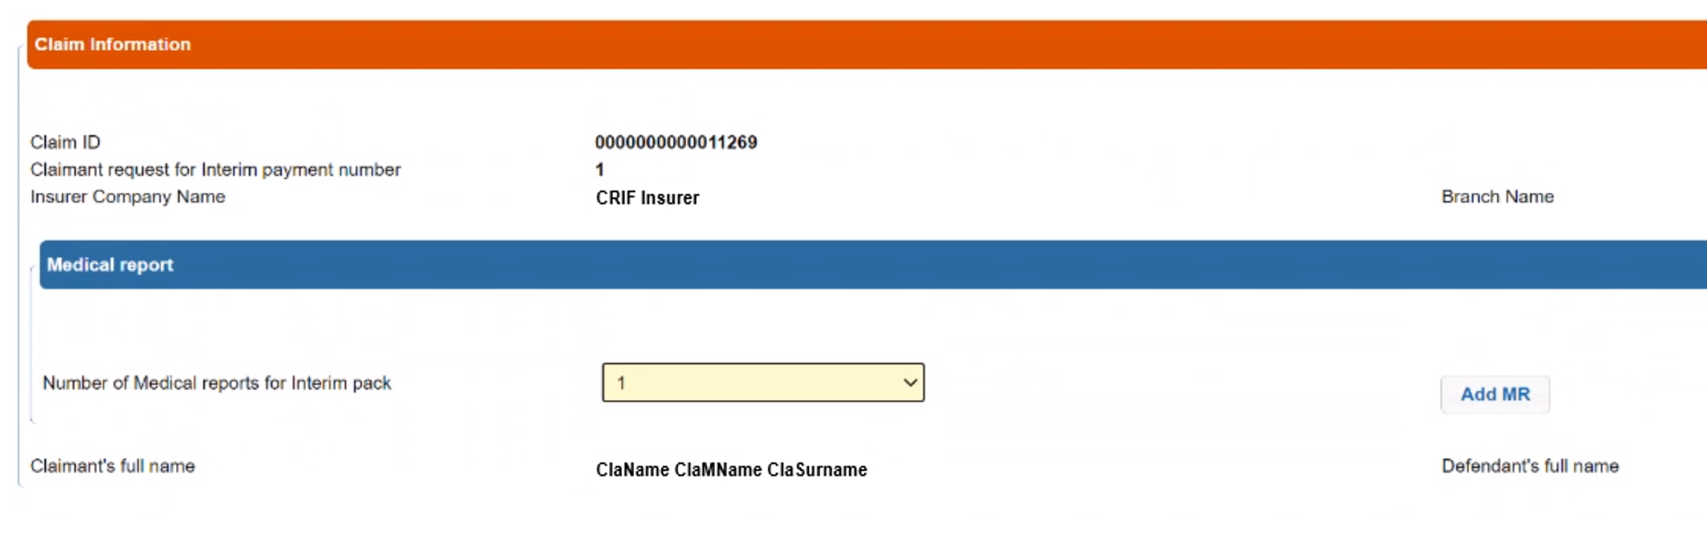
5. Stage 2 Settlement Pack and Interim Settlement Pack - Medical Report
Where 'Whiplash (Tariff)" selected in CNF, the inclusion of at least 1 medical report for stage 2 settlement pack will become mandatory.

Slide 8
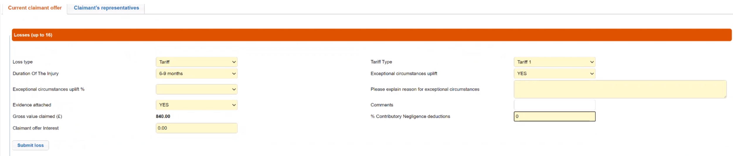
6. Stage 2 Settlement Pack - New loss type of 'Tariff' added
A new loss type of 'Tariff' has been added.
For this 'Tariff' loss type, additional 'Tariff Type' dropdown has been added to capture 'Tariff 1' or 'Tariff 2', an additional supporting field of 'Exceptional Circumstances Uplift (Yes/No) has been created, and where the response to this is 'yes', 2 additional fields have been created, 'Exceptional circumstances uplift %' and 'Please explain reasons for exceptional circumstances'

Slide 9
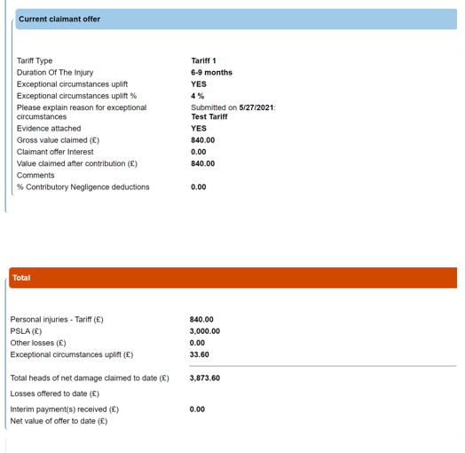
7. Settlement Pack 2 - S2SP Payment Request Breakdown
Claimants offer in SP2 will show in the Interim Settlement Pack how much of the interim payment request relates to the tariff amount, how much relates to PSLA and how much relates to other losses which includes every other loss apart from PSLA and Tariff

Slide 10
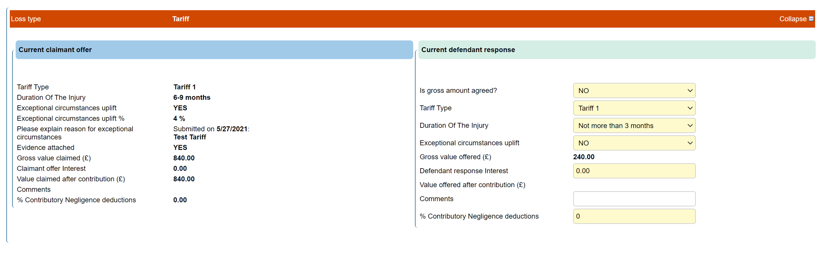
8. Settlement Pack 2 - Counter Offer
Where the Claimant has requested a Tariff loss and an uplift, on the counter offer the Defendant is able to amend the following: % of the uplift, Application of the uplift, Type of Tariff (move from 1-2 or 2-1), Duration of the injury, but cannot amend the reason for the exceptional circumstances

Slide 11
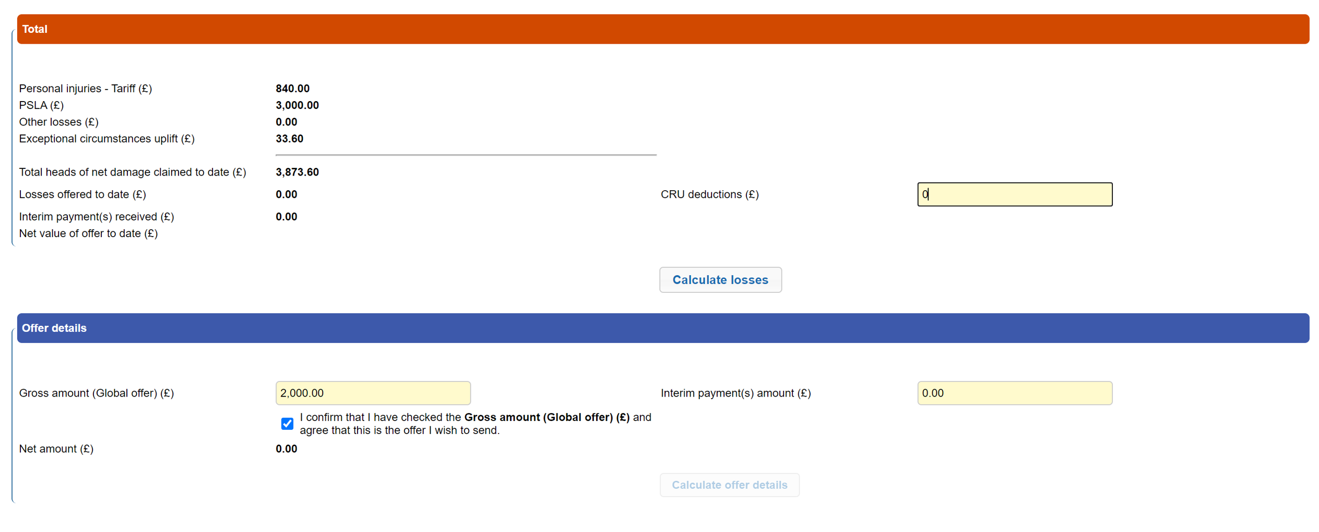
9. Settlement Pack 2 - Payment Request Breakdown
The Compensator is able to see the tariff amount, the amount for non-whiplash damages and the amount of other losses requested to date.

Slide 12
10. Settlement Pack 2, continued
Settlement Pack 2 - the changes outlined in the slides above will also apply to:
  Stage 2 Settlement Pack Form Counter Offer - New Counter offer form (CR)
  Stage 2 Settlement Pack Counter Offer - Additional Counter offer decision (COMP) in case of “New counter offer”: “History of counter offers” Tab is not modified.
  Stage 2 Settlement Pack agreement decision - Agreement decision (CR) only in the Tab “Current claimant offer and Defendant response” in read only.
  Stage 2 Settlement Pack agreed - SettlementOfDamagesOrRepudiation (COMP) only in the Tab “Current claimant offer and Defendant response” in read only.

Slide 13
11. New Exit Point
A new exit point of 'Wrong Portal' has been added to the existing Reason Code dropdown for both CR and Comp.
Applies to the following activities:
Activity 80_10 – Exit Confirmation by CR
Activity 90_10 – Exit Confirmation by CM
Activity 80_20 – Exit Acknowledged by CR
Activity 90_20 – Exit Acknowledged by CM

Slide 14
12. Removed Exit Reason
Deleted the exit reason “Claim below £1000”.

