Slide 1
Claims Portal Release 6 Workshop

Slide 2
Agenda
Welcome to guests – Tim Wallis, Chair of Claims Portal
Overview of the Claims Portal project and general update – Kaye Sydenham, Claims Portal Service Delivery Manager
Early sight of tech specs relating to the project - Chiara Zambelli and Ileana Magno – CRIF project team
Break 10 minutes – tea, coffee and biscuits
Details of the support available to implement the changes ahead of the agreed go live date – Nevia McKiernan Account Manager, CRIF
Q&A session - CRIF and Project team
Close and thank you – Chair of Claims Portal

Slide 3
Welcome
Tim Wallis
Claims Portal Independent Chair

Slide 4
Kaye Sydenham
Service Delivery Manager
MIB MSL

Slide 5
Background to Release 6

Slide 6
Release Drivers 1. Reduce Risk 2. Compliance 3. Improve system performance 4. Improve customer satisfaction 5. Enhance fraud prevention

Slide 7
1. GDPR
Functionality to delete a claim in order to comply with data Subject Rights:
Right to be Forgotten
Right of Rectification
Right to Restrict Processing
Web and A2A
Enhanced the Data Subject Access Request Process

Slide 8
2. Organisation Name
Making the organisation name field on the CNF un-editable to ensure claims are submitted in the name of the account that was registered on the Portal.
Web and A2A

Slide 9
3. Attachments
The introduction of a limit of the number of attachments that can be added to a claim.
4. Notifications
To reduce the number of automated notifications to Users.
Both Web and A2A

Slide 10
5. Referral Source
An additional field has been added to the CNF as recommended by the Insurance Fraud Taskforce to capture the referral source and share the data with the Insurance Fraud Bureau (IFB).
The information will not be visible to/or shared with compensators.
Web and A2A

Slide 11
6. CRU Validation
In Release 5 the CRU field on the CNF was amended to only accept 6 characters comprising of 3 alpha characters and 3 numeric characters (as per the CRU reference number).
The same changes have been implemented in Release 6 for A2A.
A2A only

Slide 12
7. Global offers
Align the way the system calculates a global offer on A2A with web.
A2A only
8. Retention of a claim at end of Stage 2
Retention of a claim and its attachments for 12 months from the date a court proceedings pack is created. The attachment history which captures when documents are attached or deleted will be retained for the same period of time.
Web only

Slide 13
Go Live
8 October 2018

Slide 14
Other Activities in 2018……
Tackling messaging on the Portal
A new Audit
A new User Agreement

Slide 15
Claims Portal Change Requests Release 6 A2A

Slide 16
Chiara Zambelli
&
Ileana Magno
CRIF

Slide 17
Agenda
Progress to date
A2A Changes
RTA/ELPL Claims:
Organisation name, Branch Name and address prefilled
Max Number of attachments CR and COMP
Gross amount calculation in Stage 2 Counter Offer
CRU Reference Number validation
Claim Deletion for GDPR Reason
Reduction of time out notification
Funding attributes removal
RTA Claims: Referral source information
Technical Specifications
Integration sites and testing
Preparation to go live

Slide 18
PROGRESS TO DATE-Timeframe & milestones
A2A INTEGRATION
(10 WEEKS)
TEST SITE
AVAILABLE
GO LIVE
23 July 2018
8 October 2018

Slide 19
Regression testing
If you are interested in performing regression testing on R6 please remember to add Release 5 claims.

Slide 20
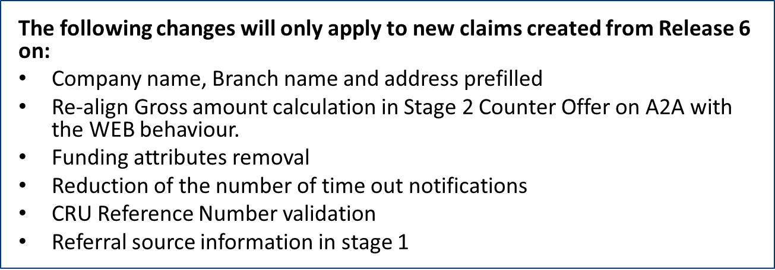
Release 6 changes

Slide 21
Company Name, Branch Name and Address pre-filled
Company Name
From RELEASE 6 onwards it will not be possible to use a company name different from the one registered on the Claims Portal’s Administration system, even if in the XML request is present a different company name.
Branch Name
It can be added as free text or it is possible to use the [PREFILLED] placeholder and in this case the system will use the AsUser’s branch name present on the Claims Portal’s Administration system

Slide 22
Company Name, Branch Name and Address pre-filled
Address
From RELEASE 6 on the node Address is conditionally mandatory
The address is mandatory if the Branch Name is not present in the XML
The system will use the Company’s address saved on the Claims Portal’s Administration system irrespective of any address provided in the request XML.
The address is optional if the Branch name is present in the request XML
If the address is present in the XML request the system will use that provided
If the address is not present in the XML request the system will use the AsUser’s branch address present on the Claims Portal’s Administration system

Slide 23
RTA and ELPL Claims
NEW FIELDS in CNF : BranchName
AddClaim
New OPTIONAL attribute
DocumentInput/ClaimAndClaimantDetails/ClaimantRepresentative/CompanyDetails/@BranchName
GetClaim
New attribute attribute
Data/ClaimAndClaimantDetails/ClaimantRepresentative/CompanyDetails/@BranchName
ResendRejectedClaim
New OPTIONAL attribute
DocumentInput/ClaimAndClaimantDetails/ClaimantRepresentative/CompanyDetails/@BranchName

Slide 24
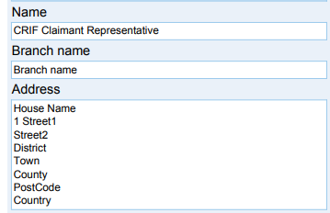
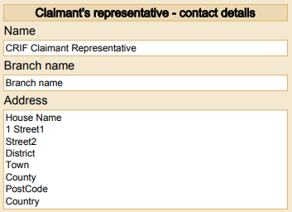
RTA Claims
Printable docs changed to include BranchName
CNF
CNF Insurer Response
Defendant Only CNF

Slide 25
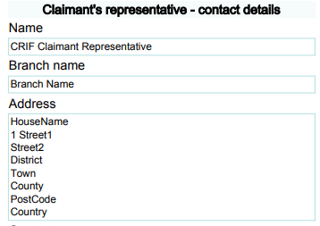
ELPL Claims
Printable docs changed to include BranchName
CNF
CNF Insurer Response
Defendant Only CNF

Slide 26
RTA and ELPL Claims
Limit on the max number of attachments allowed
The max number of attachments allowed for a claim will change and diversified between the Claimant Representative and the Compensator. The new limits are the following:
Max Number of attachments allowed for Claimant Reps: 40 attachments
Max Number of attachments allowed for Compensators: 10 attachments
The current checks on the max size allowed for a single attachment (4MB) and the max total size of the attachments (20MB) remain the same, they have not been changed.
The validation sequence is:
1. single file size (max 4MB)
2. total files size (max 20MB)
3. number of files

Slide 27
RTA and ELPL Claims
Gross amount calculation in Stage 2 Counter Offer
The change will be to re-align A2A to work in the same manner as the current web application for the calculation of the gross amount.
The change will relate to the function:
AddStage2SPFCounterOfferByCM () in case of Accept counteroffer the value provided in the Gross Amount is set to the last value offered by CR.

Slide 28
RTA and ELPL Claims
CRU Reference Number validation
Validation of the CRU Reference number will be implemented to re-align A2A to work in the same manner as the current web application. The change will be regarding to the functions:
COMPAddInterimSPFResponse()
COMPAddS2SPFResponse()
The new validation rules are the following:
Length: Maximum 6 characters
Format: First three characters – 3 alpha (either uppercase or lowercase), Next 3 chars- 3 Numeric

Slide 29
RTA and ELPL Claims
Claim Deletion for GDPR Reason
A new functionality will be introduced on the Administrative site to delete a claim for GDPR reasons.
When a claim is deleted for GDPR reason by an Organisation, a notification will be generated to inform the other party that the claim has been deleted.
This new notification will be retrievable with the GetNotificationList() A2A function. The text of the new notification is the following:
Deletion of claim <applicationID>: Data Subject Rights
Please note that this notification will be visible only to the last COMP user and the last CR user who worked on the claim before the deletion.
The notification will remain available for 14 calendar days from the date of the deletion of the claim.

Slide 30
RTA and ELPL Claims
Claim Deletion for GDPR Reason
The impacted functionalities are the following:
SearchClaim
New OPTIONAL field (present only if the claim has been scheduled for GDPR deletion)
tns:searchClaimsResponse/claimInfosListResponse/claimsList/gdprClaimDeleted
GetClaimStatus
New OPTIONAL field (present only if the claim has been scheduled for GDPR deletion)
//element(*,tns:getClaimsStatusResponse)/claimInfo2Response/gdprClaimDeleted
GetClaimsList
New OPTIONAL field (present only if the claim has been scheduled for GDPR deletion)
tns:getClaimsListResponse/claimsListResponse/claimsList/gdprClaimDeleted

Slide 31
RTA and ELPL Claims
Claim Deletion for GDPR Reason
GetClaimsList() there will be only a change in the schema but there will be no other changes regarding the use of the function.
The GetClaimsList() functionality retrieves all the claims present in the worklist of the AsUser used to perform the call but a claim scheduled for GDPR deletion is removed from all the worklists and is not assigned to any user therefore is not visible in the response of the GetClaimList ().

Slide 32
RTA and ELPL Claims
Reduction of the number of timeout notifications
The system will reduce the number of time out notifications generated for the timeout events.
The notification removed from the system will be the “1 day left” notification (where present).
There will be no impact on the other notifications and on the GetNotificationList() A2A function.

Slide 33
RTA and ELPL Claims
CNF Funding attributes removal
From Release 6 onwards the attributes related to the Funding fields will be removed from the CNF and will not be generated any longer.
For the claims created before Release 6 the attributes of the section Funding remain available.
The functions impacted by this change are the following:
AddClaim()
ResendRejectedClaim()
GetClaim() only because these attributes will not be retrieved anymore for the new claims

Slide 34
ELPL Claims
CNF Funding attributes removal
Attributes removed from ELPL
DocumentInput/LiabilityFunding/Funding/ @FundingUndertaken | DocumentInput/LiabilityFunding/Funding/@PolicyDate
DocumentInput/LiabilityFunding/Funding/@Section58 | DocumentInput/LiabilityFunding/Funding/@LevelOfCover
DocumentInput/LiabilityFunding/Funding/ @ConditionalFeeDate | DocumentInput/LiabilityFunding/Funding/ @PremiumsStaged
DocumentInput/LiabilityFunding/Funding/@Section29 | DocumentInput/LiabilityFunding/Funding/@IncreasingPoint
DocumentInput/LiabilityFunding/Funding/@ICName | DocumentInput/LiabilityFunding/Funding/ @MembershipOrganisation
DocumentInput/LiabilityFunding/Funding/@ICAddress | DocumentInput/LiabilityFunding/Funding/ @OrganizationName
DocumentInput/LiabilityFunding/Funding/@PolicyNumber | DocumentInput/LiabilityFunding/Funding/ @AgreementDate
DocumentInput/LiabilityFunding/Funding/@Other | DocumentInput/LiabilityFunding/Funding/@OtherDetails

Slide 35
ELPL Claims
ELPL Printable document Section F (Funding) Removal
CNF, CNF Insurer Response and Defendant Only CNF

Slide 36
RTA Claims
CNF Funding fields removal
Attributes removed from RTA
DocumentInput/LiabilityFunding/Funding /@FundingUndertaken | DocumentInput/LiabilityFunding/Funding/@LevelOfCover
DocumentInput/LiabilityFunding/Funding/@Section58 | DocumentInput/LiabilityFunding/Funding/ @PremiumsStaged
DocumentInput/LiabilityFunding/Funding/ @ConditionalFeeDate | DocumentInput/LiabilityFunding/Funding/@IncreasingPoint
DocumentInput/LiabilityFunding/Funding/@Section29 | DocumentInput/LiabilityFunding/Funding/ @MembershipOrganisation
DocumentInput/LiabilityFunding/Funding/@ICName | DocumentInput/LiabilityFunding/Funding/ @OrganizationName
DocumentInput/LiabilityFunding/Funding/@ICAddress | DocumentInput/LiabilityFunding/Funding/ @AgreementDate
DocumentInput/LiabilityFunding/Funding/@PolicyNumber | DocumentInput/LiabilityFunding/Funding/@Other
DocumentInput/LiabilityFunding/Funding/@PolicyDate | DocumentInput/LiabilityFunding/Funding/@OtherDetails
DocumentInput/LiabilityFunding/Funding /@ConsideredFreeLegalExpIns

Slide 37
RTA Claims
RTA Printable document Section L (Funding) Removal
CNF and CNF Insurer Response
Defendant Only CNF

Slide 38
RTA Claims
NEW FIELDS in CNF : ReferralSourceInfo
AddClaim()
New MANDATORY field
DocumentInput/ClaimAndClaimantDetails/ClaimantRepresentative
/ReferralSourceInfo
New CONDITIONAL MANDATORY attributes
DocumentInput/ClaimAndClaimantDetails/ClaimantRepresentative/
ReferralSourceInfo/@ReferralSource
DocumentInput/ClaimAndClaimantDetails/ClaimantRepresentative/
ReferralSourceInfo/@CMCName
DocumentInput/ClaimAndClaimantDetails/ClaimantRepresentative/
ReferralSourceInfo/@MOJCMCAuthorisationNumber
DocumentInput/ClaimAndClaimantDetails/ClaimantRepresentative/
ReferralSourceInfo/@ReferralSourceWebsite
DocumentInput/ClaimAndClaimantDetails/ClaimantRepresentative/
ReferralSourceInfo/@ReferralSourceSource

Slide 39
RTA Claims
NEW FIELDS in CNF : ReferralSourceInfo
ResendRejectedClaims ()
New MANDATORY field
DocumentInput/ClaimAndClaimantDetails/ClaimantRepresentative
/ReferralSourceInfo
New CONDITIONAL MANDATORY attributes
DocumentInput/ClaimAndClaimantDetails/ClaimantRepresentative/
ReferralSourceInfo/@ReferralSource
DocumentInput/ClaimAndClaimantDetails/ClaimantRepresentative/
ReferralSourceInfo/@CMCName
DocumentInput/ClaimAndClaimantDetails/ClaimantRepresentative/
ReferralSourceInfo/@MOJCMCAuthorisationNumber
DocumentInput/ClaimAndClaimantDetails/ClaimantRepresentative/
ReferralSourceInfo/@ReferralSourceWebsite
DocumentInput/ClaimAndClaimantDetails/ClaimantRepresentative/
ReferralSourceInfo/@ReferralSourceSource

Slide 40
Referral source field and attributes behaviour
The ReferralSourceInfo field is mandatory and its attribute @ReferralSource can assume the following values:
R: Regulated CMC
E: Existing client
P: Private referral
A: Advertising (non-internet)
F: Via firm’s website
W: Via other website
O: Other sources
N: Prefer not to say

Slide 41
Referral source field and attributes behaviour
If the attribute @ReferralSource is equal to R then the attributes @CMCName and @MOJCMCAuthorisationNumber are mandatory and cannot be present if @ReferralSource is different from R
If the attribute @ReferralSource is equal to W then the attributes @ReferralSourceWebsite is mandatory and cannot be present if @ReferralSource is different from W
If the attribute @ReferralSource is equal to O then the attributes @ReferralSourceSource is mandatory and cannot be present if @ReferralSource is different from O

Slide 42
Visibility of Referral Source
PLEASE NOTE THAT:
The ReferralSourceInfo field and all its attributes are not visible in any of the claim stages and cannot be retrieved with the GetClaim() function.
The ReferralSourceInfo field and all its attributes are not visible in any printable documents.

Slide 43
Preparation to Go live – RELEASE 6 MANAGE NEW VERSION
8 October: GO LIVE DATE
DIFFERENT VERSIONS OF CLAIMS
USE GetSystemProcessVersion() to get the
VERSION MAJOR and VERSION MINOR
(AS FOR PREVIOUS RELEASES)

Slide 44
Preparation to Go live – RELEASE 6 MANAGE NEW VERSION
CHECK THE PROCESS VERSION OF A CLAIM TO CALL THE RIGHT A2A FUNCTION
ie. not later
than Monday
24 September
PROCESS VERSION FROZEN AT A GIVEN DATE
(RISK: no bug fixes)
RTA CURRENT
VERSION = 5
NO NEW VERSIONS
ELPL CURRENT
VERSION = 5
GO LIVE
8 October

Slide 45
Break – 10 minutes

Slide 46
Nevia McKiernan
CRIF

Slide 47
Preparation to Go Live

Slide 48
Technical Documentation
TECH SPECS DRAFT version- A2A schema: describes the fields of Forms (XSD files)
Tech Specs A2A schema final version - 23 July
TECH SPECS - DRAFT A2A interface: describes the I/O of functions (WSDL file)
Tech Specs A2A interface final version - 23 July
PHASES AND NOTIFICATIONS: spreadsheet with the list of phases and notifications
A2A Release Notes DRAFT version- : describes the changes to the A2A
A2A Release Note final version - 23 July

Slide 49
Integration sites and testing
WEB TESTING (WEB Training site)
→ https://training.rapidclaimsettlement.org.uk
A2A TESTING (A2A Integration site)
→ https://piptesta2a.crif.com

Slide 50
Integration sites and testing
A2A QUERIES to be directed to the Helpdesk
→ helpdesk@rapidclaimsettlement.org.uk
with e-mail subject “A2A QUERY RELEASE 6”
please include XML input and output with your queries, without this information we cannot investigate.
CHECK YOUR TEST CREDENTIALS
please check that your TEST credentials are enabled a couple of weeks or so before you start testing

Slide 51
Production Site
DRAFT CLAIMS
All draft claims in the production site on the go live date will be deleted.

Slide 52
Q&A

Slide 53
Next steps
We will send out the draft tech specs to you
We will put a webinar together for the Web Users nearer the release time
Please get in touch with any queries relating to Release 6 via the Claims Portal helpdesk

Slide 54
Thank you for coming along Don’t forget to sign up to our newsletter on www.claimsportal.org.uk

